Slide 1
Overview of language
What?
Method of communication, either spoken or written, consisting of the use of words in a structured and conventional way
Note
Point-of-view: Speaker’s or writer’s
Content: their thoughts

Slide 2
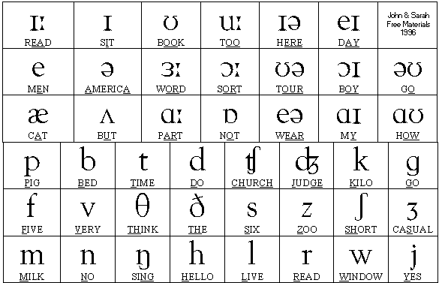
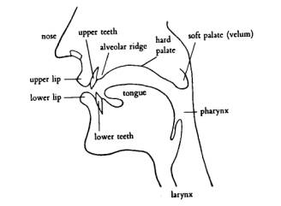
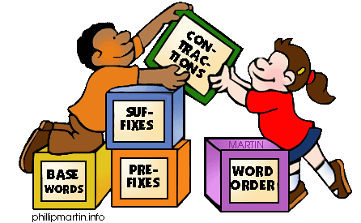
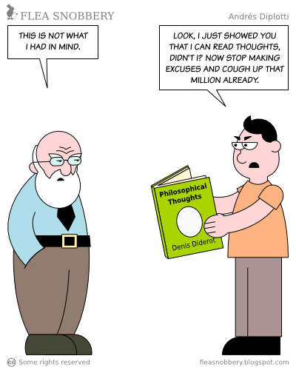
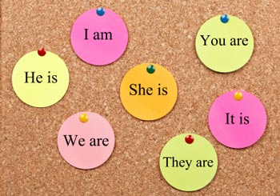
3 parts of language
Language
Phonetics
Phonology
(Sound)
Grammar
Morphology
(Structure)
Semantics
Pragmatics
(Meaning)

Slide 3
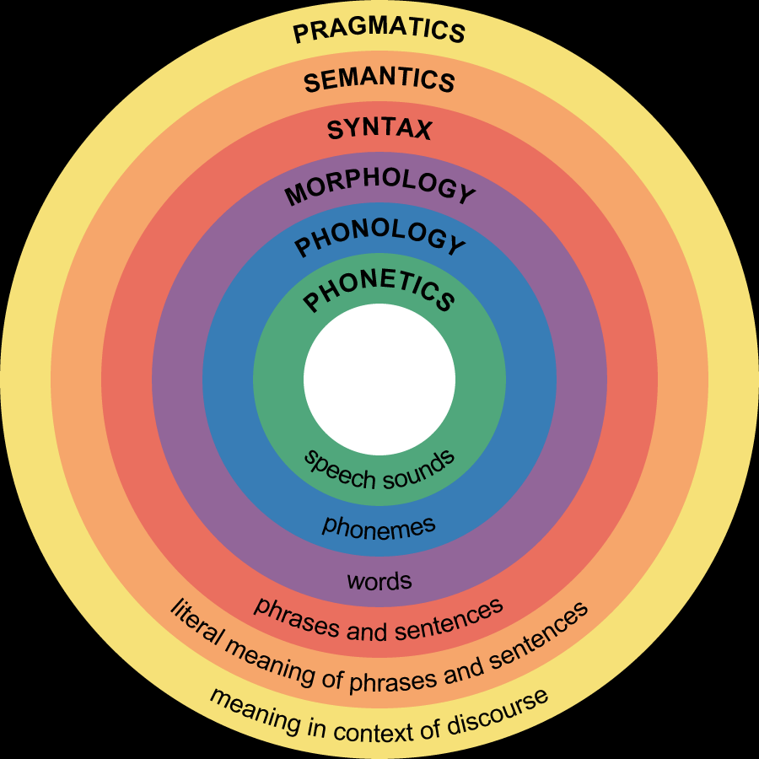
3 parts of language

Slide 4
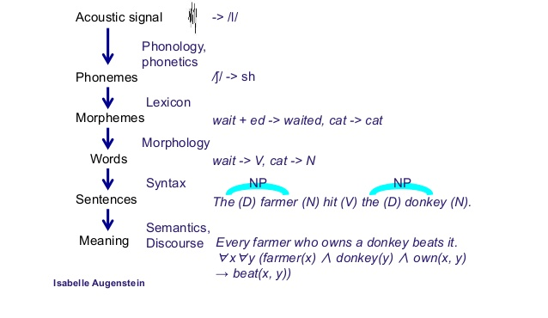
3 parts of language

Slide 5
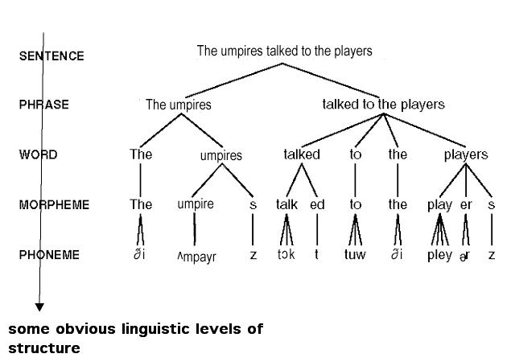
3 parts of language

Slide 6
Sample tree diagrams
S
C
C
P
P
P
P
P
P
W
W
W
W
W
W
W
John kicked the ball and Harry caught it.
S: Sentence C: Clause P: Phrase W: Word

Slide 7
Sample tree diagrams
S
C
P
P
P
W
W
W
W
W
W
W
W
W
The old lady has been anxious about her car.
S: Sentence C: Clause P: Phrase W: Word

Slide 8
Small tests – Build tree diagrams
Go away!
Jim sold his bicycle to a friend.
Martha loves cats.
The two men were fishing for trout in the clear stream beside the woodman’s cottage.
The committee elected the oldest member president for the coming year.
Your apple pie looks really delicious.

Slide 9
Small tests – Build tree diagrams
Young Jim has been looking for tadpoles in the village pond.
She gave him a look which betokened the trouble.
Old Mother Hubbard went to the cupboard to fetch her poor dog a bone.
When she got there the cupboard was bare, and so the poor dog had none.

Slide 10
Small tests – Hints
Go / away!
Jim / sold / his bicycle / to a friend.
Martha / loves / cats.
The two men / were fishing / for trout / in the clear stream / beside the woodman’s cottage.
The committee / elected / the oldest member / president for the coming year.
Your apple pie / looks / really delicious.

Slide 11
Small tests – Hints
Young Jim / has been looking for / tadpoles / in the village pond.
She / gave / him / a look which betokened the trouble.
Old Mother Hubbard / went / to the cupboard / to fetch her poor dog a bone.
When / she / got / there / the cupboard / was / bare /, and / so / the poor dog / had / none.

Slide 12

Any question?

